Slide 1
Strengthening Families
Tuesday 1st October 2019

Slide 2
History of Strengthening Families
Strengthening Families is a direct response by Salford City Council to the growing number of women repeatedly losing their children to the care system due to a range of issues such as domestic abuse, poor parenting, crime, drug and alcohol abuse.
Evidence (Salford) A significant numbers of repeat pregnancies in parents who have had children removed:
Over a 5 year period (Salford LA 2005-2012) 228 mothers and 644 children were involved in repeat removal cases
Over same period 65% of all looked after children were from mothers who had had more than 1 child taken into care
Average of 17 months between first time mothers appearing in court with an infant and second time she appears with another infant
The hardest to reach families were resistance to accessing support or advice , therefore safeguarding concerns left unresolved following removal of child
No support prior to 20 weeks gestation, which identified missed opportunity
Health inequalities, - families not accessing health services consistently
“In 2012-13 councils spent an average of £137 a day, or just over £50,000 for the whole year, supporting each child they looked after.”
Source: Audit Commission analysis of statistics published by the Department for Education (DfE) on the number of and expenditure on looked after children

Slide 3
What is Strengthening Families?
Strengthening Families is an intensive specialist parenting programme for pregnant women/families who are pre 20 weeks gestation and are at risk of their unborn child being removed from their care and have had previous children removed AND parents who have already had children removed and remain currently non-pregnant.
Intensive support is offered through the Strengthening Families Practitioners, the programme has a dedicated Midwife, x 2 Lead Practitioner, x4 Practitioners and a Manager.
Depending on need this support can be a programme of bespoke 1:1 sessions, group work sessions by attending the Health in Pregnancy and Parenting (HIPP) course or both.
The programme aims to reduce the number of children going into care and prevent mothers from getting into the cycle of repeat removals.
Strengthening Families allows vulnerable families to be indentified and receive the earliest possible help, ensuring babies have healthier outcomes and are safeguarded pre and post birth.
The programme provides support for first five years of the child’s life, ensuring children are School Ready.
The programme also supports mothers and fathers for two years where children have been removed around healthy lifestyles.

Slide 4
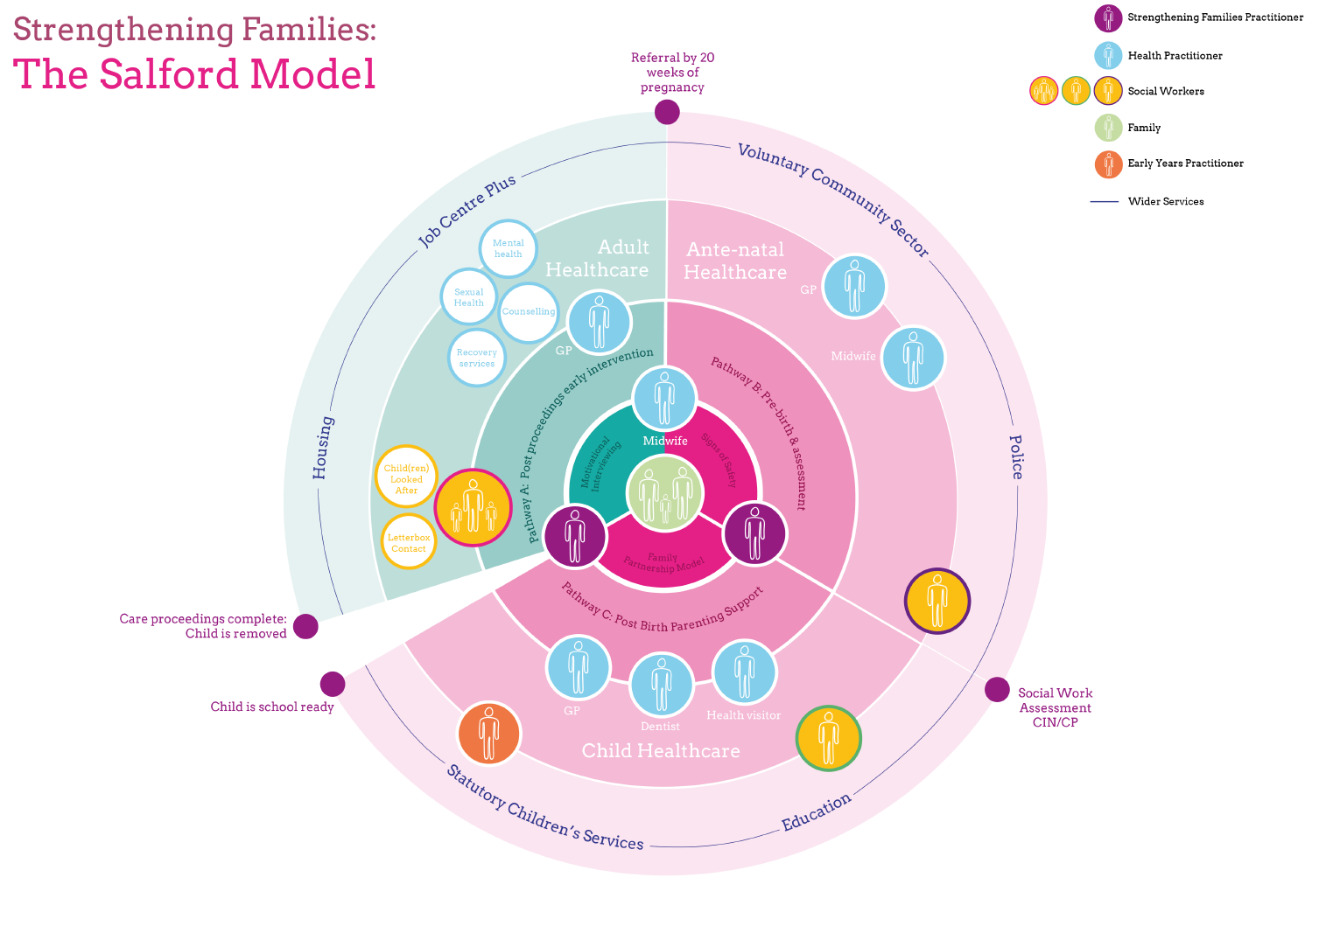

Slide 5
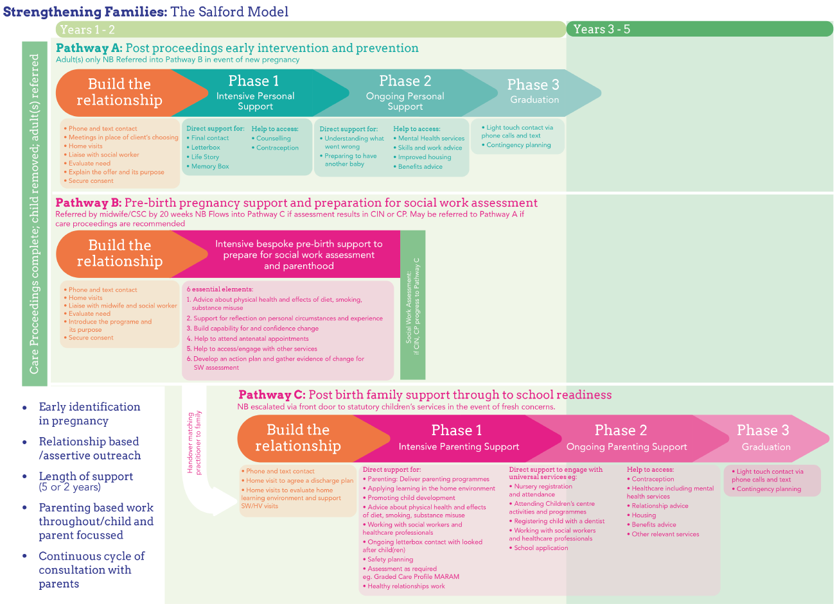

Slide 6
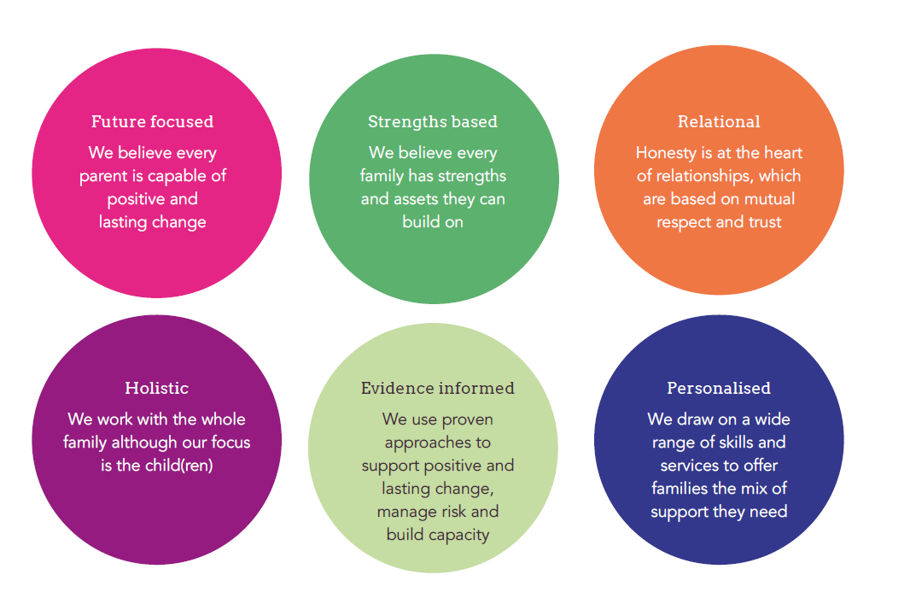
Core Values

