Slide 1
GM Innovation Spread & Scale Programme: No Wrong Door Chantel Brown (GMCA) Sayma Khan (Salford City Council)

Slide 2
Background and GM Context
Developed in 2014: North Yorkshire
Integrated service for adolescents with complex needs wrapped around a “HUB”
Outreach Offer
Adopted in 14 areas nationally
6 adopters in GM
GM Cost Benefit Analysis
Who it’s for:
Edge of Care and In Care

Slide 3
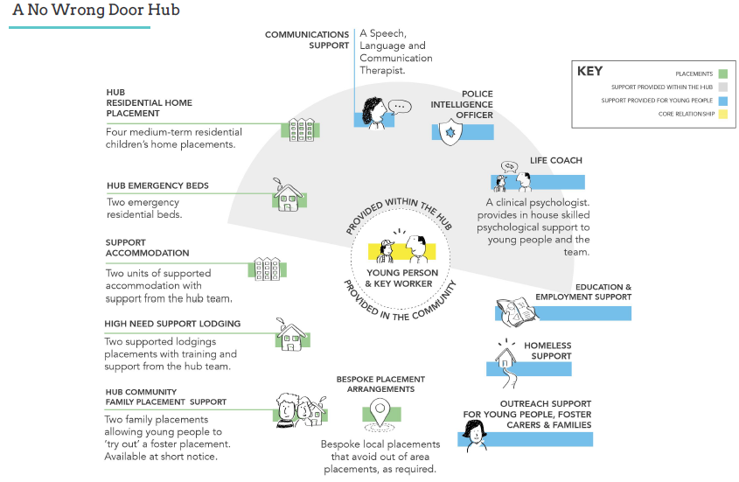

Slide 4
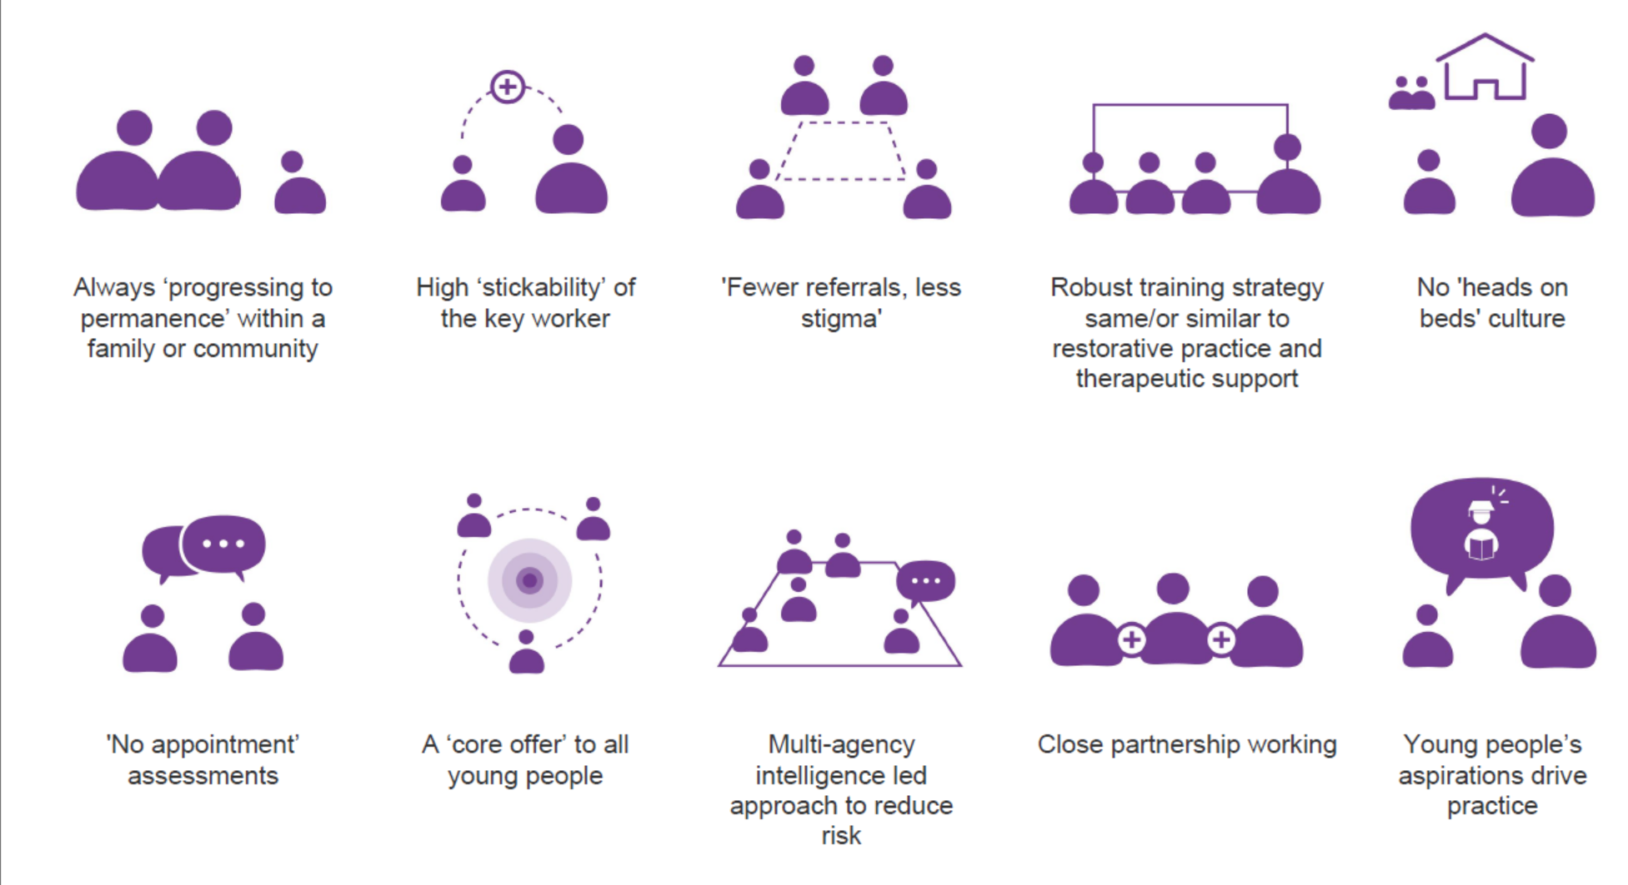
Distinguishing Features

Slide 5
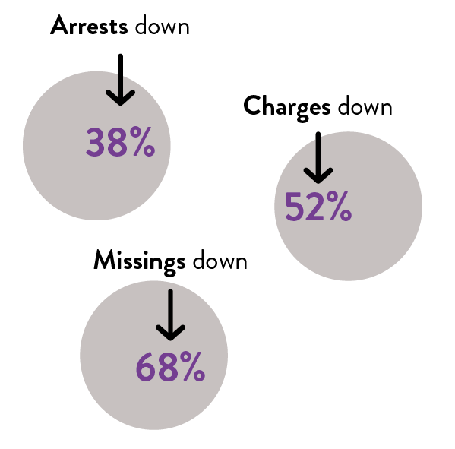
Evidence and Impact
One in four NEET young people went on to engage in education, employment or training.
Young people spent 55% less time in care than those who weren’t referred to No Wrong Door.
86% of young people remained out of care and were supported in their own families.
Notes:
Evaluation also demonstrated significant savings to health £160K to CAMHS, £300K for speech and language, £200K to police

Slide 6
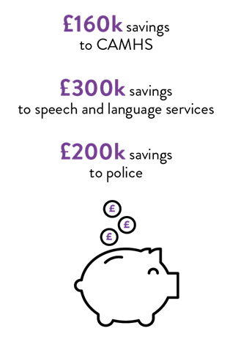
Evidence and Impact

Slide 7
Salford Children Services Route29
Sayma Khan

Slide 8
The WHY?
‘Lost Tribe’ Adolescents
Short period in care
Placement breakdowns
Complex Safeguarding
Not about £££ - Outcomes

Slide 9
Video: What did our Young People say?

Slide 10
IMPLEMENTATION: The WHAT?

Slide 11
SALFORD PROVOCATIONS
Would this be good enough for my child?
Are we managing risk for the organisation or risk to the young person?
Why can’t we, what’s the best that could happen?
Is there a shared approach to supporting/caring across partner agencies
What kind of adult do they want to be: in 5 years, 25/35/50
Are we going the extra mile to help young people achieve their ambitions?

Slide 14
CHALLENGES
NOT a new project! New way of working
Culture change across workforce
Perceptions ‘just another children's home’
Managing risk differently
Fostering
Hub Design – Trauma informed

