Slide 1
New Beginnings Greater Manchester
The community project
www.newbeginningsgm.com
@NewBeginningsGM

Slide 2
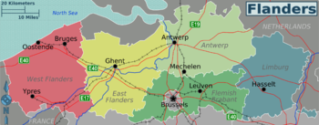
Stobbe: The beginning
How can we expect parents to parent to the standard we expect, if they have experienced trauma, disadvantage and had to face other societal challenges?
When families are part of a peer support network, parents are less likely to feel isolated and stigmatized….and more likely to learn and engage with their children and other professionals

Slide 3
Referral process
Self referrals or referral received from a social care professional
Families in the child protection process, in public law outline (PLO) or parents who have children on care orders
First visit takes place with referring professional, New Beginnings member of staff and peer mentor
Coffee morning to meet the other parents and peer mentors, accompanied by referring professional/ friend/ family

Slide 4
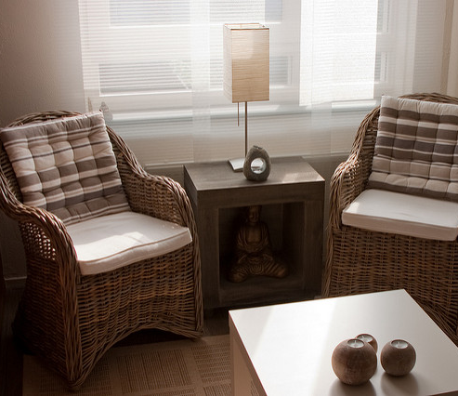
How it works…..
FIRST STAGE:
Timetable
The programme lasts for 24 weeks (or more)
Tuesday:
Self care sessions (energy healing, art therapy and holistic therapy)
Thursday:
Trauma informed group work
Weekly:
1:1 sessions with key worker; Counselling
Also representation:
Attend professional meetings with parents-
core groups; child protection conferences; contact; any other meeting

Slide 5
SECOND STAGE
Peer mentoring on completion of the programme
(4 weeks)
Peer mentoring: social pedagogy in action
Benefits: Embeds learning; builds on shared personal experience and offers of genuine empathy; focuses on an individual's strengths not weaknesses and works towards the individual's wellbeing and recovery.
This Photo by Unknown Author is licesed under CC BY-SA

Slide 6
The secret to New Beginnings: Relationships, connections and trust
The secret to helping parents turn their lives around is simple. It is through the relationships we build with them and them with us.
Connection comes before correction. Power, authority and judgment only leads to lack of trust, fear and disconnection.
Parents can hear you when you hear them. They will listen when they know they can trust you.

Slide 7
The practical stuff by Tracey McMahon: Housing - meeting the needs of parents in care proceedings Benefits and income - changes to welfare reforms. Criminal Justice support for victims of domestic abuse
But parents cannot concentrate on healing when they have to deal with overwhelming socio-economic issues.
This Photo by Unknown Author is licensed under CC BY-NC-ND

Slide 8
Story so far…..
Cohort 1 & 2: 11 parents
10 women and 1 man have completed the 6 month programme
Where are we now? 7 peer mentors/ parent leaders
5 women have completed peer mentor training, 1 woman in the process, 1 woman due to start January.
The remaining 4 parents are still connected.
Future plans for peer mentors/ parent leaders
Recruiting new staff; preparing to deliver workshops; presentations and working with new parents in Cohort 3.

