Slide 1
‘IT’S IN THEIR CULTURE’: WORKING WITH GYPSIES, ROMA AND TRAVELLERS
Dr Dan Allen
d.allen1@salford.ac.uk

Slide 2
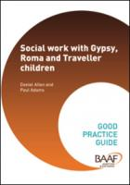
“Gypsy” “Roma” “Traveller”
Gypsy, Roma, Traveller
Romani Gypsies
Irish Travellers
New Travellers
Circus People
Boat People
Fairground and Show People
Scottish Travellers
Welsh Travellers
Roma

Slide 3
What are the concerns?
3 times more likely to live in alternative care than any other child.
Minimal evidence of kinship friends or family care
Although the pre-care experiences of Gypsy, Roma and Traveller can be traumatic and gruelling, their experience of being fostered or adopted can be often far worse.
Significant trauma and disrupted attachements
“Eradicate Gypsy existence and culture” (Liegeois, 1986; McVeigh, 1997; Fraser, 1995; Vanderbeck, 2005)

Slide 4
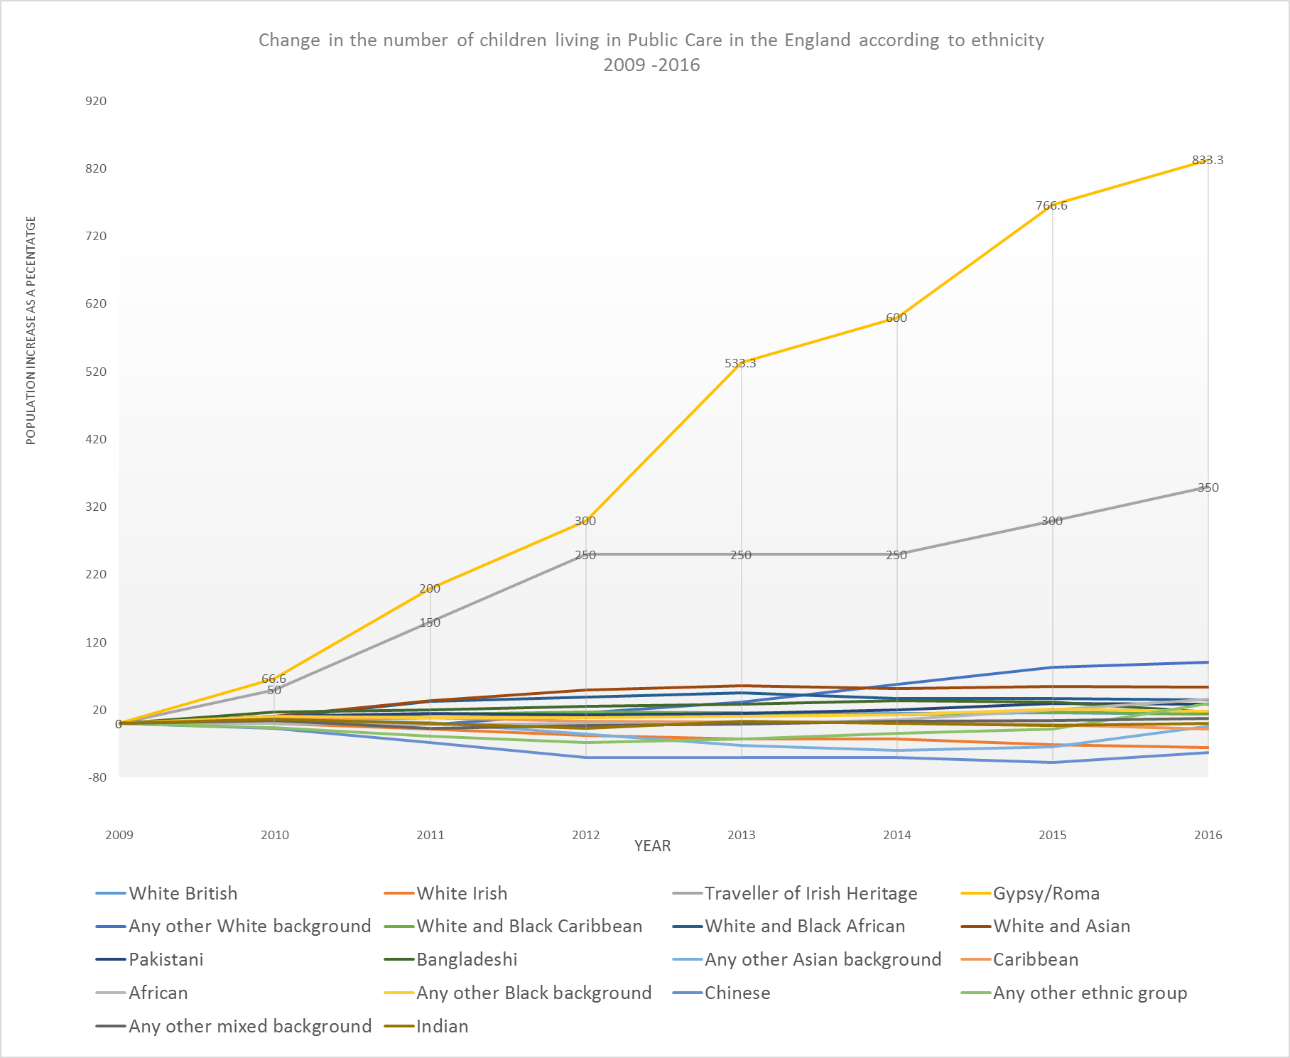
Disproportionate increase?

Slide 5
“it’s in their culture”
Two common aspects of practice:
Pathologisation of Gypsy, Roma and Traveller communities can lead to oppressive and coercive practice.
In care proceedings children can be separated from their families and communities in the belief that the conceptual Gypsy, Roma or Traveller ‘culture’ is the primary object of concern (Allen, 2012)

Slide 6
Reliable evidence?
“There are signs of significant concern in relation to his cognitive and emotional development. Although these in part may be culturally determined, this does not mean [the child] cannot learn”
“[the child] is at risk of not meeting his cognitive abilities which is due to a lack of concentration and ability to memorise. I think he is capable of learning but he is not receiving adequate emotional and cognitive stimuli. This is in part related to the culture he finds himself in”
“[the child] should not be allowed unsupervised contact as the Gypsy family will abduct him”
“ The harm [the child] suffers relates to being exposed to the oppositional behaviour of the grandmother…as seen in Travellers”

Slide 7
“it’s in their culture”
Two common aspects of practice:
Cultural relativism can be the failure to intervene when intervention might be needed.
At these times the drive to place a child with friends and families can fail to take into account the pressure that will be placed on the family system and the views and wishes of the child themselves (Allen, 2016)

Slide 8
Reliable evidence?
During the positive suitability assessments children can be placed with friends and families because, in situations where parents are unable to care for their children, it is believed that they should be cared for by their extended family (BSCB, 2014).
As well as creating opportunities for interfamilial conflict, which if not fully anticipated can escalate in some very violent ways, family members can also feel obliged to accept responsibility for children and large sibling groups even if they do not have the resources to do so (Harrington, 2014).
the court can become quite a challenging environment if guardians, family court advisors and social workers are seen to not fully understand or lack knowledge of an individual family’s culture family (BSCB, 2014).

Slide 9
Central message
Action justified though pathologising or cultural relativist reactions are likely to fail Gypsy, Roma and Traveller communities, as well as the Gypsy, Roma and Traveller children themselves.
In particular recognition of the deletion of the revocation of s1(5) from the welfare checklist in the Adoption and Children Act 2002 by the Children and Families Act 2014, culturally competent care proceedings must maximise cultural attachments.

Slide 10
Promoting positive attachments
Care planning must involve direct involvement of the Gypsy, Roma and Traveller child in the milieu of the birth culture, as difficult as this might be at times.
To reverse the risk of cultural isolation, and ostracism, care plans must develop and refine this understanding by highlighting meaningful opportunities for Gypsy, Roma and Traveller children living in care to feel and experience pride in their own cultural identity.

Slide 11
Promoting positive attachments
Children’s guardians, family court advisors and social workers need to genuinely value the opportunities that the birth parents, extended family and community members can offer in terms of helping the child to feel good about their Gypsy, Roma and Traveller heritage, amongst other benefits.
They must also spend time with Gypsy, Roma and Traveller families to help them make sense of their own responses to interfamilial separation, enabling them to understand that their importance to their child does not diminish just because the child has been adopted or fostered.

Slide 12
Conclusions
The central thesis of this paper is no different to the approach needed to work effectively with any other family.
Care and Adoption proceedings will frighten members of Gypsy, Roma and Traveller communities if they have had very little contact with formal government structures, and in any case feel under threat from them.
A core principle demands that the child is placed at the centre of all decision making processes. It is not good enough to justify pathologising or cultural relativist decisions against sweeping statements like ‘it’s in their culture’, because, as with all families, the behaviours, beliefs, values, and symbols which constitute ‘culture’ are fluid, complex and often individually changeable.

