Slide 1
The Role of Expert Evidence in Family Proceedings: Psychologist and Psychiatrist
Dr Kate Hellin & Dr Frank Margison
26th February 2020

Slide 2
What are experts trying to achieve?
“Expert evidence ...is often integral to the safeguarding of children. The Courts rely heavily upon the objectivity, professional competence and integrity of experts.
The Courts expect careful and balanced opinions. Clinical judgment has to be soundly based and objectively justified” (Rix, 2011)

Slide 3
What we will cover
Types of expert: Psychologists and Psychiatrists
Key questions for experts
Practice Direction 25A (revised 2011)
What sort of expert do you want?
Multiple experts
Capacity reports

Slide 4
What is expert evidence?
“...expert opinion about a question that is not within the skill and experience of the Court”
Practice Direction 25A
Alternate sources open to the Court
Social work evidence
Evidence from other professionals (e.g. midwives/ HVs)
Treating clinician’s views (if willing)

Slide 5
Types of expert
Related to NAI / CSA / neglect
Paediatrician
Paediatric radiology
Haematology
Child psychiatrist / psychologist
Mental health and competence of parents
Clinical psychologist
Forensic psychologist
Psychiatrist
Child and Family psychiatrist
Neurologist / neuropsychiatrist / neuropsychologist

Slide 6
Key questions for paediatric experts
Was this an injury? Accidental or NAI?
Is there evidence of sexual abuse or physical neglect?
Is the development of the child within the normal range- if not, why not?
Is there evidence of fabrication, exaggeration, induction of illness (FII)?
Contentious areas:
“Shaken baby syndrome”
“Brittle bone disease”

Slide 7
Key questions for psych-experts
Diagnosis of formulation of mental health problems
Prognosis
Treatment and timescales for change
Ability to care for the child(ren) despite the psychological difficulties
Contentious areas:
Personality disorder / chronic trauma / FII
Diagnostic confusion-
mild bipolar / ASD / ADHD / EUPD / drug misuse

Slide 8
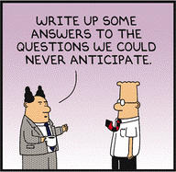
What are wenot trying to achieve?

Slide 9
What are we trying to achieve?
Reports that make a difference:
Accurate diagnosis/formulation and predictions
Risk analysis
Practical suggestions about interventions
A clear opinion on the issues that matter to the child
Where possible, advice regarding the parents and their capacity to parent
Robust reports
Outlining the evidence on which conclusions are made
from bundle and from personal knowledge
Specialised test results
Re-examination of evidence (incl. blood results, X-rays)

Slide 10
Types of psychiatric reports
Knowing what is needed and what is available
Capacity report only
Only addresses capacity of client to instruct and conduct proceedings [2-3 hours]
Basic Report
On formal diagnosis, treatment and prognosis (narrowly defined) [6-10 hours]
Full psychiatric report
As above plus discussion about likely causes, complicating factors, engagement, parenting problems, risk [13-18 hours]
Highly complex report (eg in FII)
As above plus very detailed analysis of evidence and medical records and alternative scenarios [25 hours+]

Slide 11
Types of psychological reports
Knowing what is needed and what is available
Cognitive and/or Capacity report only
Psychometric assessment, usually of cognitive functioning and opinion re capacity of client to litigate and parent [5-10 hours]
Full psychological report of one or more adults
History from documents (GP records essential), from interview, psychometric assessment of mood and personality to form a formulation and predictions for parenting [20+ hours]
Family assessment – adults and children
As above plus observation at contact, interviews with schools etc [dependent on family size]

Slide 12
Which psychiatric specialist?
Adult general psychiatry
Diagnosis, prognosis and treatment of most problems
? Specialist in addictions psychiatry
? Specialist in psychotherapy
? Specialist in learning disability
Child and adolescent psychiatrist
Very young parents
Impact on the child
Attachment issues
Forensic psychiatrist
Criminal law issues in parallel
Long offending history
Detailed risk assessment

Slide 13
Which Psychologist
Clinical Psychologist
“Adult”
“Child”
Learning disability
Forensic Psychologist
Educational Psychologist
Neuropsychologist

Slide 14
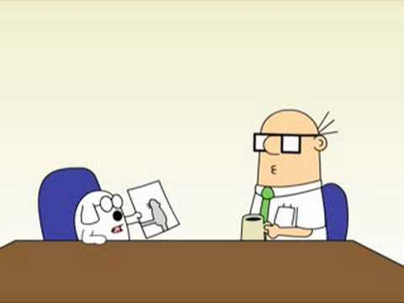
Formal testing needed?

Slide 15
Psychiatrist or psychologist?
Key similarities:
Both give an overview of the problems
(diagnosis or formulation)
Both can analyse risk
(Forensic specialty in both do more formal test-based analysis)
Both can recommend treatment / therapy /other interventions
(different comfort zone?)
Both can give a prognosis
Both may comment on problems in parenting (depending on experience)
Key differences:
Psychologist
Formulation
Formal testing including IQ
Detailed personality assessment with measures
Psychiatrist
Formal diagnosis
Medication review and recommendations

Slide 16
Limitations of report
Diagnosis difficult
Especially in poorly defined areas such as
Borderline personality, Bipolar Type II, adult ADHD, Autism, Somatisation disorders / FII
Presentation different to other reports
Incomplete information
Multi-layered problems
several diagnoses, early childhood trauma, abusive relationships, and problems with taking excess medication, drugs or alcohol
Motivation to change may be quite recent so difficult to assess fairly

Slide 17
Example 1: Where a report may help: Single expert
Depression and early trauma [Psychiatrist or Psychologist]
Depression triggered poorly controlled behaviour, but may have good prognosis when treated effectively
Easily mislabelled Emotionally Unstable PD
Mother coping poorly, not engaging ?IQ
Psychologist able to test I Q and functional ability
Formulation and psychological treatment plan
[Psychology example]

Slide 18
Example 2 Where a report may help: Complex case
Mother with sudden change in behaviour at age 30, uses cannabis, has volatile relationships, several antidepressants and GP has queried “bipolar”
Mother also has multiple physical complaints and admissions for extensive investigations for “fits”
Baby of 9 months has low weight gain for age, and unexplained bruising to her head
Reports to consider:
General paediatrician to look at development and possible NAI
May need paed. radiologist and other specialists
Psychiatrist to look at multiple diagnoses
Possibly needs a neuropsychiatrist / neurologist
Psychologist to look at personality issues in depth

Slide 19
Example 3 Where a report may help – single expert
?FII because baby has been to GP or A&E 36 times
Children: multiple pathology and investigations several conflicting diagnoses given; and possibly some exaggeration. ? Factitious or induced illness
Parent: early history of abuse. Mum has multiple verifiable pathology with possible exaggeration plus overuse of analgesics. Dad stable on methadone.
Multiple experts needed to get a full picture.
Very extensive work on mother’s medical notes and detailed review of children’s medical notes from multiple hospitals
Poor engagement with assessments

Slide 20
References:
A Handbook for Expert Witnesses in Children Act Cases (2nd Ed) [Rt Hon Lord Justice Wall (2007) Family Law: London]
Expert Psychiatric Evidence [K Rix London: RCPsych (2011)]
Psychologists as expert witnesses in the Family Courts in England and Wales: Standards, competencies and expectations. [Guidance from the Family Justice Council and the British Psychological Society (BPS: 2016)]
Paediatricians as expert witnesses in the Family Courts in England and Wales: Standards, competencies and expectations [Guidance from the Family Justice Council and the Royal College of Paediatrics and Child Health (RCPCH 2018)]
Mental Capacity Act Code of Practice Code of practice giving guidance for decisions made under the Mental Capacity Act 2005.
https://www.gov.uk/government/publications/mental-capacity-act-code-of-practice

Slide 21
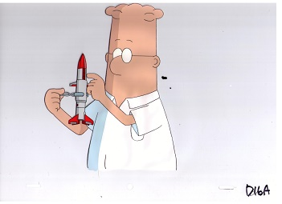
Thank you!

